Slide 1
20Th Argentinian Congress of Haematology
Can the hematological disease emerge from an emotional conflict?
Gustavo Chiozza

Slide 2
Can the hematological disease emerge from an emotional conflict?
?
… but how?
No
Yes
… but which one?

Slide 3
¿How can an emotional conflict appear as an hematological disease?
¿Which emotional conflict can appear as an hematological disease?

Slide 4
HOW
WHich
Explanation
Head
Left hemisphere
Theory
¿Emergent?
Understand
Heart
Right hemisphere
Example
¿Emotional Conflict?
First Part
Second Part
MIND - BODY relationship
ANEMIA RESEARCH

Slide 5
First Part:
PsYque-Soma relationship

Slide 6
Philosophy
Science
Speculations
Facts
Imagination
Reality

Slide 7
Two different forms of Existence
That which really exists
That which in reality does not exist…
… but exists in the imagination of philosophers

Slide 8
Philosophy is in charge of addressing this type of thought.
This way of ordering existence in two different types is known as:
CARTESIAN DUALISM

Slide 9
MATTER
(res extensa)
IDEA
(res cogitans)
Body
Somatic
In the world
Perception
Soul
Psychic
In the mind
Memory

Slide 10
CARTESIAN DUALISM
PSYCHOGENESIS
SOMATIC
PSYCHIC
¿?
SOMATOGENESIS

Slide 11
An epistemological model that only considers two exclusive existents (the psychic and the somatic), leaves no room for a third existent: that which being not psychic nor somatic, relates both existents (psychic and somatic).

Slide 12
SOMATIC
PSYCHIC
¿-?

Slide 13
«The mysterious leap from the mind to the body is the dead-end of Cartesian dualism»
hematolOgical DISEASE
EMOTIONAL CONFLICT
Emergent

Slide 14
Remembrance of perceptions
Mind
2º
PsYCHIC
Matter
Brain
Neuron
Thought
Imagination
1º

Slide 15
But what comes first,
the kidney or the IDEA of the kidney?
teleology
Thought in the matter
Purpose
Meaning
Sense
Sensation
Affect
That which we call Psychic is the Sense
Notes:
----- Notas de la reunión (14/10/11 09:16) -----
El riñón no existiría si no existiera primero la idea de filtrar.
La finalidad, la intención, no es la causa.
La causa antecede al efecto, la finalidad lo sucede.
Por eso se llama a la teleología "la causa final".
Al pensamiento causal no se le aplica la idea de "origen".

Slide 16
Somatic
MATTER
Perception
Memory
We said
IDEA
Psychic
SENSE
Sensation
Now we say
Remember Feelings

Slide 17
How
Which
PercepTiOn
SENSATION
What can be seen, heard, touched, smelled and tasted.
What can be weighted and measured.
Characterizes the OBJECT.
The feelings, the affects and the desires.
Only the one who feels it knows about it.
Characterizes the SUBJECT.
Physical
Psychic
Signs
SYMPTOMS

Slide 18
The double existence of man
THE ONTIC
BEING
Man is what he is
But also
THE SUFFERING
THE PATHIC
Man is what he is not…
and he wants to, can or should be
Notes:
----- Notas de la reunión (14/10/11 09:33) -----
Ya exploramos la Sensación. Hablemos un poco más de la Percepción.

Slide 19
Bees have a visual spectrum different to the human’s one. So...
What colour are the flowers?
Are things as I see them?
Or are they as you see them?
The perception that should account for objects, rather than being OBJECTIVE…
… is SUBJECTIVE!
Notes:
----- Notas de la reunión (14/10/11 09:51) -----
Cada especie tiene las capacidades perceptivas que necesita para sobrevivir. Las víboras tienen sensores de temperatura para saber, a la hora de morder, dónde están las arterias. Las abejas ven en las flores marcas que las ayudan en el aterrizaje.
ahora si ellas ven en las flores cosas que nosotros no vemos...
Madre hay una sola...

Slide 20
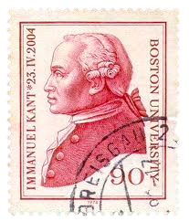
Reality - the thing - in itself is unknowable. I can only know the thing in me.
noumenon
observer
properties
categories
«phenomenon»
OBJECTIVITY

Slide 21
Perception
DISEASE
SOMATIC
¿?
concepts
OBSERVER
Consciousness
noumenon
PSYCHIC
Sensation

Slide 22
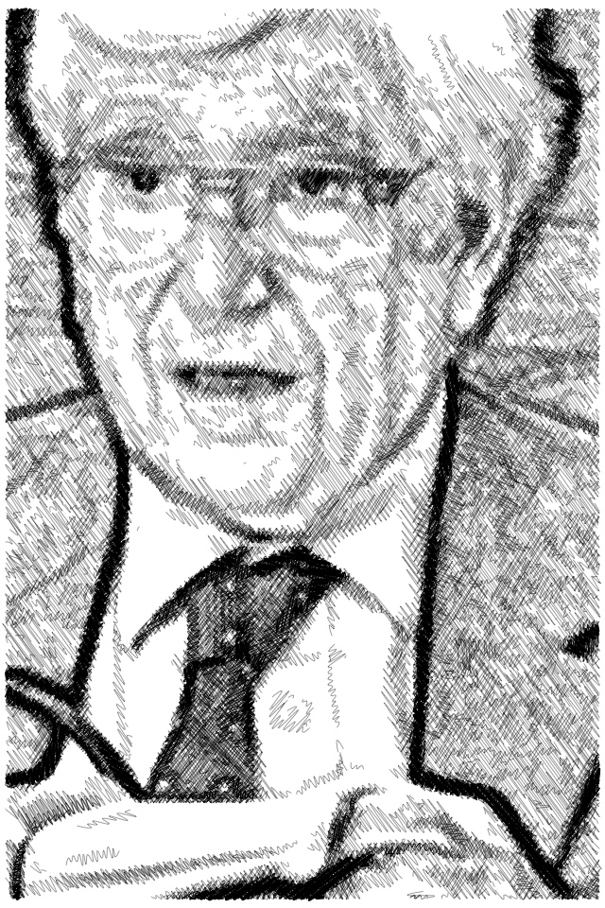
DOUBLE ORGANIZATION OF KNOWLEDGE IN CONSCIOUSNESS
Psychic and somatic aren't two different existents; they are two ways of "categorizing" that the consciousness has.
We call somatic to what we can perceive; and we call psychic to that which has a sense that we can understand .
The disease «itself» is not psychic nor somatic.

Slide 23
FROM THIS EPISTEMOLOGICAL APPROACH
Every Disease
CAN BE PERCEIVED AS A MATERIAL ALTERATION
CAN BE UNDERSTOOD IN ITS UNCONSCIOUS MEANING

Slide 24
AS UNCONSCIOUS MEANING
Disease
Always appears interweaved with the life of the patient; it is never something alien, external or casual
It is the way the patient has found to deal with a Vital Drama
It's a Story, centered on an Affect that the patient has Repressed

Slide 25
These stories have typical elements that repeat themselves in different patients that have the same disease.
Every disease has a typical biographical screenplay.
Clinical Evidence
«A disease is so typical from the psychological point of view as it is from the physical point of view»

Slide 26
SPECIFICITY
«Each disease corresponds to a Repressed Affect»
«To discover that Affect in each disease is the goal of our research»

Slide 27
The Affect
It’s a process of bodily discharge
Conciousness registers the discharge as a series of Somatic Sensations that due to its specific configuration are recognized by it as a particular affect
The discharge takes place following a specific, inherited pattern for every affect, that we call Innervation Key

Slide 28
Discharge of the Affect
Innervation Key
Heart rate
Intestinal Transit
Blood Pressure
Pilo- erection
Mydriasis
discharge
FEAR
Typical Affect

Slide 29
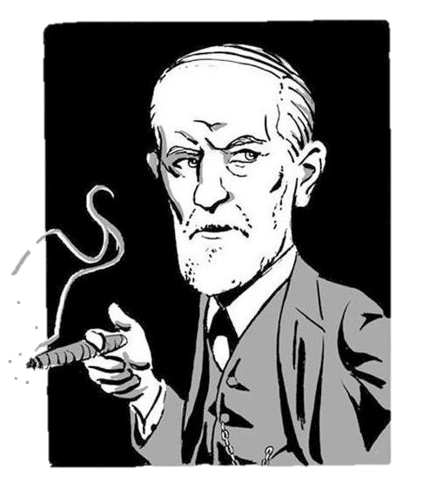
The genuine reason for repression is to prevent the development of an UNPLEASANT AFFECT

Slide 30
Neurosis
The affect can be unpleasant because it’s linked to a certain representation.
Repression can replace the original representation for an other one.
This way the affect is registered as such, but it’s not unpleasant anymore.

Slide 31
Somatic disease
ONE of the bodily innervations receives the total investiture of the key.
Consciousness no longer recognizes the discharge as an affect, given that it is not the typical discharge.
Consciousness registers an exaggerated somatic sensation as a BODILY SYMPTOM
The affect is unbearable regardless of the representation to which it is attached.
The repression to prevent the affect UNSTRUCTURES it’s innervation key.

Slide 32
Normal discharge of the affect
Innervation Key
Heart rate
Intestinal Transit
Blood Pressure
Pilo- erection
Mydriasis
discharge
FEAR
Typical Affect

Slide 33
Repression of the affect fear
The innervation key is
unstructured
Heart rate
Intestinal transit
Blood pressure
Pilo- erection
Mydriasis
DIARRHEA
discharge
Bodily Symptom

Slide 34
Repression of affect crying
The innervation key is
unstructured
Conv. Diaf.
Mucus
Etc
Shedding tears
Sobs
EPIPHORA
discharge
Bodily Symptom

Slide 35
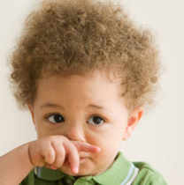
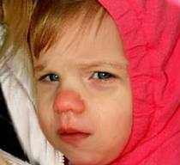
In brief
¿CRYING?
cold
flu
Understood in its unconscious meaning, the symptom constitutes an act full of sense; a bodily 'gesture' that expresses an unconscious fantasy.
BODILY
SYMPTON
REPRESSED
AFFECT
SYMBOL
Emergent

Slide 36
Part Two:
THE SPECIFIC UNCONSCIOUS MEANING OF ANEMIA
«A PSYCHOANALYTIC STUDY OF ANAEMIA»
Luis Chiozza – Gustavo Chiozza
M. Estela Bruzzon – Mirta F. de Dayen – Gloria I. de Schejtman

Slide 37
BLOOD
Liquid tissue
Coagulation
Excretion
Transport of nutrients
Immunity
Transport of O₂
HEMOGLOBIN
CO₂

Slide 38
ANEMIA
↓O₂
↓Hemoglobin
Symptom
Sign
Asthenia
Pallor
2º
Dyspnea
Tachicardia

Slide 39
Each function of the body pursues a purpose.
That purpose is also the sense of that function; its meaning.
We seek to link, specifically, each function of the body with a sense in the soul.
Many organs exert more than one function. But in general, one of those functions - for being the most representative one - represents the whole organ and its functions.

Slide 40
«We are the same blood»
White blood cells
Identity
Red blood cells
«Blood came back to my body»
Life

Slide 41
We believe that the role of transporting oxygen is the most representative of all of the functions of the blood.
It is the most compelling function
The Hb represents 95% of the proteic content of the RBC
The RBC are + 90% of the «cell» population of the blood
It is a function so inherent to the blood as it’s quality of being red, given that both characteristics depend on Hb.

Slide 42
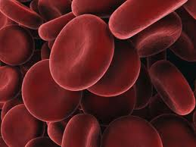
Combustion
energy
Oxygen transport
Fire
Life
O₂
BLOOD
«Blood is life»

Slide 43
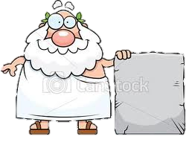
Anemia
AN
HAIMA
WHITHOUT BLOOD
Erythrocytes
Hemoglobin
WITHOUT
LIFE
LIFE

Slide 44
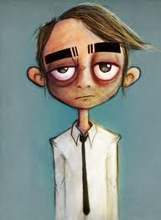
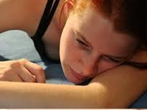
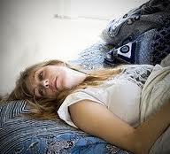
ASTHENIA
Without blood
Without vitality
Without energy
Without Combustion
Withaut fire
Without oxygen
Dejection

Slide 45
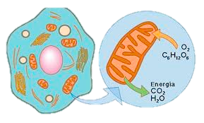
Pulmonary breathing
dyspnea
Discouragement
Anaemia
Cellular respiration
Dejection
Notes:
----- Notas de la reunión (14/10/11 10:53) -----
Espirometrías: el aliento ayuda a animarse.

Slide 46
LIFE
AHEAD
CALM
PACIFIC
ECOLOGICAL
VEGETAL
LIFE

Slide 48
BLOOD
SEX
LIFE
RED
PASSION
FIRE

Slide 49
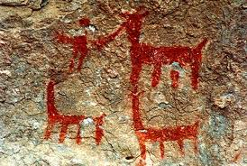
According to the primitive man, red was the first colour.
In Spanish «Colorado» means red; but also, that it has colour.
Perhaps, because of it’s association with blood, to give colour also means to give life.

Slide 50
The affects are that which give colour to life
envy
jealousy
revenge
offense
Every affect has its own colour…
boredom
anger
The RED colour represents the whole set of emotions; the Emotion in general... the Passion.
SANGUINE

Slide 51
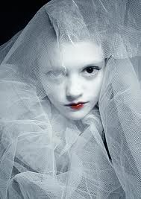
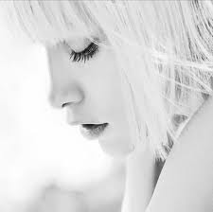
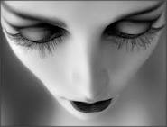
PALLOR
Not much expressive
Lifeless
Lacks Colour…
Lacks Life…
Lacks «Blood»…
Soulless

Slide 52
ISCHEMIA
PALLOR
It is an attempt to prevent a painful affect to get to the heart.
Prevent the «blood» to get to the heart.
It's like a widespread ischemia.
It is the attempt to suppress the emotional life.
coronaries
hemoglobin

Slide 53
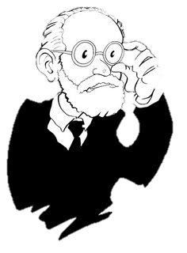
When life denies us the satisfaction of drives, an extreme alternative to avoid misery, is the attempt to kill drives, turn off the wishes, inhibit the affects …devitalize life...
«If this is achieved, then all other activity has been resigned (life has been sacrificed), to recover, through another way, only the joy of quiet.»
FREUD, 1929.

Slide 54
AFFECTS
DO NOT FEEL
PAIN
FRUSTRATION
DO NOT FEEL
DESIRES
DO NOT FEEL
INDOLENCE
IN-DOLENT
Insensitive
Impassive, Apathetic
Indifferent
Lethargic
It is not moved
Soft
Lazy
Abandoned

Slide 55
What runs through the veins
ANEMIA
WITHOUT BLOOD
BLOOD
Without passion
Passion
INDOLENCE
APATHY

Slide 56
Genital mucosa congestion
FLUSH
Arousal
Conflict with arousal
Inhibition of arousal
INDOLENCE
Because he/she imagines it excessively red, carnal, fiery.
Affect
SHAME
His life lacks passion
It is a pale reflection of the life he would like to live
Blush
More blood
More life

Slide 57
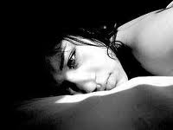
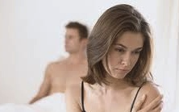
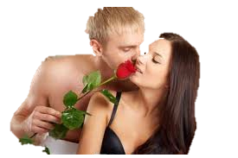
INDOLENCE
Colourless
Pale
The person dreams about what he lacks.
But because the passion is inhibited
He dreams about a love that is not carnal.
A platonic, romantic, impossible love.

Slide 58
Return of the repressed
pasSiOn
Doesn’t seek for satisfaction, but instead it feeds itself with the selfless renunciation
The idealized desire is not carnal but spiritual
LIFE
romAntic Ideal

Slide 59
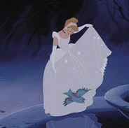
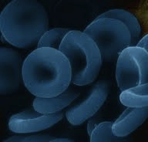
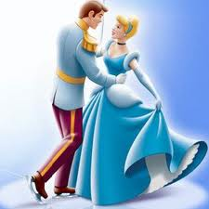
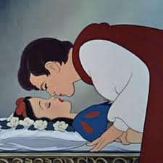
The romantic writes and describes the passionate life that he dreams about… but that he doesn’t live.
He exalts the bucolic beauty of country life … but he lives in the city.
He falls in love with a modest woman, who’s as white as the porcelain.
Also the virginal girl who dreams about Prince charming
romAntic ideal
nobility
Blue blood

Slide 60
(BRIEF PSYCHOLOGICAL PARENTHESIS
Takes away from us
BAD OBJECT
LACK
FRUSTRATION
REMOVE
Parenthesis end.)
Notes:
----- Notas de la reunión (19/10/11 18:11) -----
Me pica el bagre.
La culpa la tiene el gobierno; la gente rica.

Slide 61
Passion
INDOLENCE
DO NOT FEEL
DESIRE
DESIRE
Red
Fire
Carnal
Avoid
Pain
FEAR
romAntic IDEAL
romAntic IDEAL
LIFE
LIFE
PRINCE CHARMING
Prince charming

Slide 62
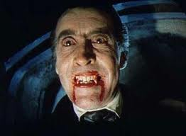
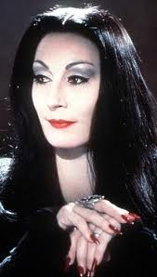
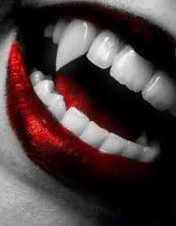
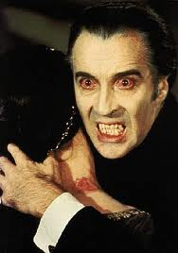
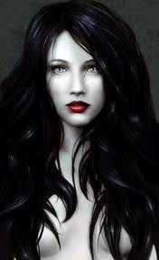
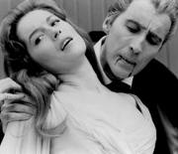
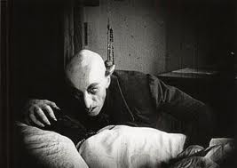
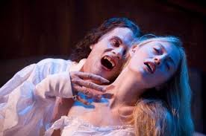
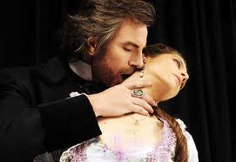
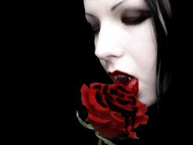
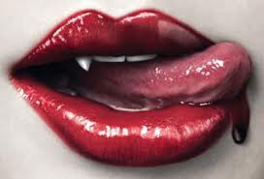
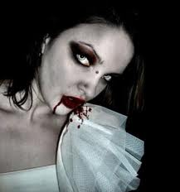

Slide 63
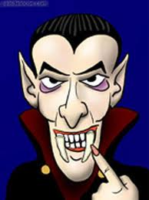
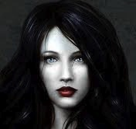
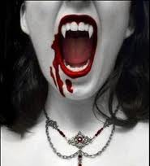
represents
ANEMIC
A living dead
Pale
Needs blood
represents
Rep.
represents
ANEMIC
FEARED
OBJECT
IDEAL DESIRED
OBJECT
Passionate
Erotic
Carnal
Blood-sucking
Fortress
Deathless

Slide 64
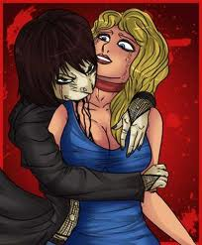
VAMPIRE
¿Myth or Reality?
Bloodsucking parasite
Bat
PORPHYRIAS
HEMO pathology
Hemolytic Anemia
Photosensitivity
Mouth open
Receding gums
Treatm. red blood cells

Slide 65
In brief
Fearing the frustration and pain
Fearing the intensity of passions
Fearing arousal, imagining that it’s too red, carnal and fiery
Affective life
DO NOT FEEL
INDOLENCE

Slide 66
INDOLENCE
Apathy
Indifference
LIFE
It becomes numbed, painless, colourless…
It has lost all motivation; all interest
It lacks passion
ROMANTIC IDEAL
The repressed desires return, but deprived of their intensity, red, and carnal.
It seems a pale reflection of the one he would like to live

Slide 67
Repression of affect INDOLENCE
The innervation key is
unstructured
↓O₂
_{Asthenia}
_{Pallor}
_{Dyspnea}
_{Tachycardia}
?
↓Tránp Hb
?
?
?
discharge
Anemia

Slide 68
Dejection
Asthenia
Lack of vitality
Pallor
Discouragement
Dyspnea
Arousal
Tachycardia
INDOLENCE
ANEMIA
Emotional
Conflict
Hematologic
Disease
Emerges as

Slide 69
Hepatic disorder
renal and urinary disorders
Renal LitHiasis
prostatic hYperplasia
Diabetes
IsCHemic cardiopathy
Essencial hipertension
Respiratory disorders
Bronchial asthma
Psoriasis
AutoiMmunitary diseases
Systemic erythematosus Lupus
MYcosis
FLU
Lower limb varicose veins
Hemorrhoids
Bony disorders
Cancer
Melanoma
Acute lymphoblastic Leukemia
Multiple sclerosis
Parkinson’s disease
Obesity
aids
Thyroid diseases
Ocular herpes
blisters, vesicles and cysts
headaches and strokes
sclerosis
Tooth disorders
Sorrow and crying
anaemia
More information
www.funchiozza.com
Thank you very much.

